Slide 1
Enhancing Business Efficiency And Customer Experience For Ali’s Shawarma Truck Near KIIT University
Project Summary and Recommendations

Slide 2
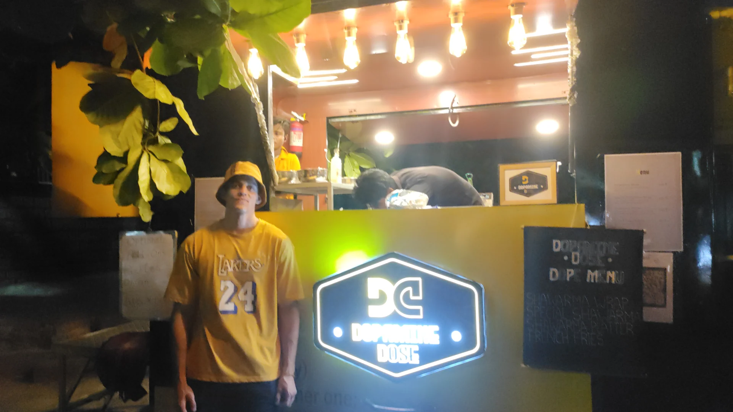
Organization Background
Name : Dopamine Dose
Registered : January 2023
Location : KIIT University, Bhubaneswar, Odisha
Owner : Ali B. Mahfoud
“Authentic Syrian Shawarma”

Slide 3
Objectives
Conduct a thorough analysis of customer preferences and transactional data.
Evaluate the current operational processes and identify areas for streamlining and efficiency management
Investigate inventory management practices and recommend strategies for minimizing waste and maximizing resource utilization.
Explore pricing strategies to ensure competitiveness while maintaining profitability.
Research potential expansion avenues and assess their feasibility and potential impact on the business.

Slide 4
Detailed Analysis Process
Data Preparation: Split data, clean datasets, establish fixed daily expenses.
Feature Engineering: Created new columns for total units sold, revenue, and profit.
Statistical Analysis: Calculated statistical parameters for revenue, profit, profit margin, and sales volume.
Trend Analysis: Plot profit trend and individual menu items against dates to identify patterns.
Sales Volume Analysis: Grouped total units sold by month to analyze sales trends over time.
Temperature Data Processing: Scraped and merged temperature data, visualize correlations with sales.
Results and Findings: Present tables, charts, and insights from the analysis.

Slide 5
Financial Analysis
Revenue
Profit
Profit-Margin
Total Revenue Collected in 56 days :
₹2,71,460
Profit Captured in 56 days :
₹1,06,540
Net profit Margin :
39.25%

Slide 6
Sales Volume
Month | Sales Volume ( Contribution )
October 2023 | 933 ( 34.82 % )
November 2023 | 1441 ( 53.78% )
December 2023 ( 5 days ) | 305 ( 11.38% )
Total Sales Volume :
2679
Contribution of Top Performing Product : 531 ( Peri Peri Chicken Shawarma ) - 19.82 %
Contribution of Least Performing Product :
31 ( Special Salsa Chicken Shawarma ) - 1.15%

Slide 7
Best sellers
01
02
03
Peri Peri Chicken Shawarma
Accounts for 19.6% of total revenue generated in 56 days
Tandoori Chicken Shawarma
Accounts for 18.9% of total revenue generated in 56 days
Schezwan Chicken Shawarma
Accounts for 17.0% of total revenue generated in 56 days.

Slide 8
Interpretation of Results
Addressing Chicken Quality
Analyzing Customer Base
Owner reluctance for online delivery partnerships.
Predominantly KIIT University students.
Optimizing Chicken Quantity
Menu Item Correlation
Weak Correlations between menu items suggesting independent customer preferences.
Adjusting chicken quantity to match menu demand,reducing waste.

Slide 9
Recommendations and Projected Impact
Optimizing Location
Menu Optimization
Increase visibility, diversify customer base, boost sales.
Cut costs by adjusting chicken quantity estimations.
Investing in Online Delivery
New fixed chicken quantity
Expand reach, improve convenience and potentially boost sales.
Disregarding the least performing products and buying chicken accordingly.
Buying 7.5 kgs instead of 10kgs disregarding the estimation for least performing products.
Projected Profit Margin : 50.27%

Slide 10
Conclusion
28,87
45
30 Days
Data-Driven Adjustments: Strategic insights drive profitability and efficiency improvements.
Optimized Operations: Chicken quantity adjustments and potential partnerships enhance cost-effectiveness.
Customer Base Insights: Understanding customer demographics aids in location optimization and service enhancements.
Future Growth Potential: Implementation of recommendations can lead to expanded market reach and increased revenue.
price per unit
locations
on market

